Slide 1

School of Computing Science and Engineering
Course Code : E2UC405B Course Name: Data Science
Unit – 1
Overview of Data Science
Faculty Name: Mr. Hariprasath K Program Name: B.Tech CSE

Slide 2
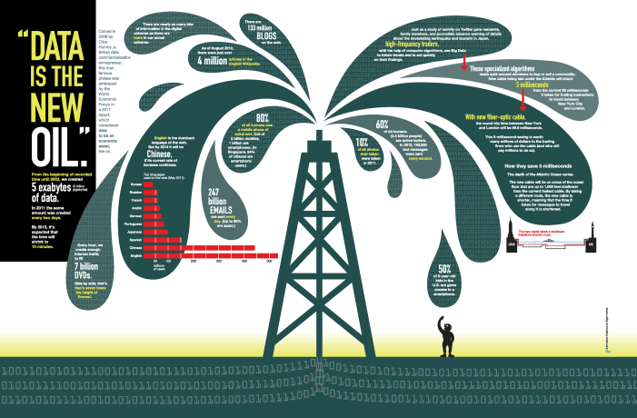
“Data is the New Oil”
– World Economic Forum 2011
Faculty Name: Mr. Hariprasath K Program Name: B.Tech CSE
Notes:
“Data is the new oil." Coined in 2006 by Clive Huby, a British data commercialization entrepreneur, this now famous phrase was embraced by the World Economic Forum in a 2011 report,
All human generated information up to 2003 is 5 exabytes. Same amount of data was generate every 2 days in 2011 and would be every 10 min NOW.
Data is just like crude oil. It’s valuable, but if unrefined it cannot really be used. It has to be changed into gas, plastic, chemicals, etc to create a valuable entity that drives profitable activity; so must data be broken down, analyzed for it to have value.

Slide 3
Data : What is?
Data is the collected information(observations) we have about something or facts and statistics collected together for reference or analysis.
Data — a collection of facts (numbers, words, measurements, observations, etc.) that has been translated into a form that computers can process
Faculty Name: Mr. Hariprasath K Program Name: B.Tech CSE

Slide 4
Data : Why does it Matter?
Helps in understanding more about the data by identifying relationships that may exist between 2 variables
Helps in predicting the future or forecast based on the previous trend of data
Helps in determining patterns that may exist between data.
Helps in detecting fraud by uncovering anomalies in the data.
Faculty Name: Mr. Hariprasath K Program Name: B.Tech CSE

Slide 5
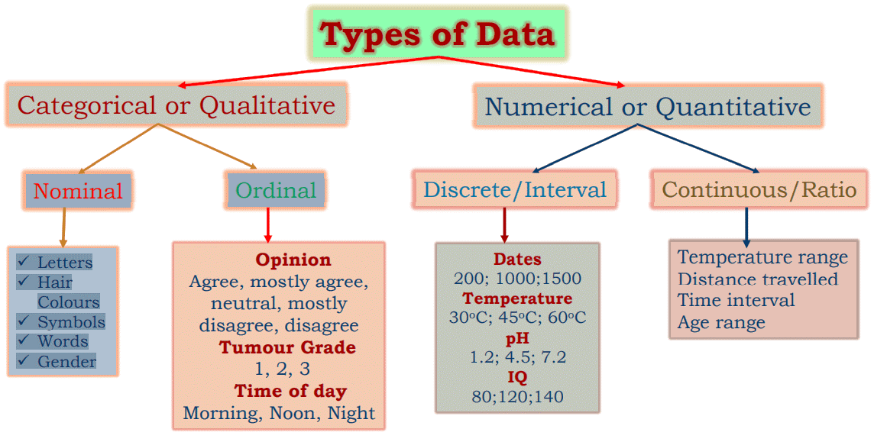
Data : Types
Faculty Name: Mr. Hariprasath K Program Name: B.Tech CSE

Slide 6
Some Definitions
Variable - any characteristic of an individual or entity. A variable can take different values for different individuals. Variables can be categorical or quantitative. Per S. S. Stevens…
Nominal - Categorical variables with no inherent order or ranking sequence such as names or classes (e.g., gender). Value may be a numerical, but without numerical value (e.g., I, II, III). The only operation that can be applied to Nominal variables is enumeration.
Ordinal - Variables with an inherent rank or order, e.g. mild, moderate, severe. Can be compared for equality, or greater or less, but not how much greater or less.
Faculty Name: Mr. Hariprasath K Program Name: B.Tech CSE

Slide 7
Some Definitions
Interval - Values of the variable are ordered as in Ordinal, and additionally, differences between values are meaningful, however, the scale is not absolutely anchored. Calendar dates and temperatures on the Fahrenheit scale are examples. Addition and subtraction, but not multiplication and division are meaningful operations.
Ratio - Variables with all properties of Interval plus an absolute, non-arbitrary zero point, e.g. age, weight, temperature (Kelvin). Addition, subtraction, multiplication, and division are all meaningful operations.
Faculty Name: Mr. Hariprasath K Program Name: B.Tech CSE

Slide 8
Some Definitions
Distribution - (of a variable) tells us what values the variable takes and how often it takes these values.
  Unimodal - having a single peak
  Bimodal - having two distinct peaks
  Symmetric - left and right half are mirror images.
Faculty Name: Mr. Hariprasath K Program Name: B.Tech CSE

Slide 9
Frequency Distribution
Consider a data set of 26 children of ages 1-6 years. Then the frequency distribution of variable ‘age’ can be tabulated as follows:
Frequency Distribution of Age
Age | 1 | 2 | 3 | 4 | 5 | 6
Frequency | 5 | 3 | 7 | 5 | 4 | 2
Grouped Frequency Distribution of Age:
Age Group | 1-2 | 3-4 | 5-6
Frequency | 8 | 12 | 6
Faculty Name: Mr. Hariprasath K Program Name: B.Tech CSE

Slide 10
Cumulative Frequency
Cumulative frequency of data in previous page
Age | 1 | 2 | 3 | 4 | 5 | 6
Frequency | 5 | 3 | 7 | 5 | 4 | 2
Cumulative Frequency | 5 | 8 | 15 | 20 | 24 | 26
Age Group | 1-2 | 3-4 | 5-6
Frequency | 8 | 12 | 6
Cumulative Frequency | 8 | 20 | 26
Faculty Name: Mr. Hariprasath K Program Name: B.Tech CSE

Slide 11
Data Presentation
Two types of statistical presentation of data - graphical and numerical.
Graphical Presentation: We look for the overall pattern and for striking deviations from that pattern. Over all pattern usually described by shape, center, and spread of the data. An individual value that falls outside the overall pattern is called an outlier.
Histogram, stem and leaf and Box-plot are used for numerical variable. Bar diagram and Pie charts are used for categorical variables.
Faculty Name: Mr. Hariprasath K Program Name: B.Tech CSE

Slide 12
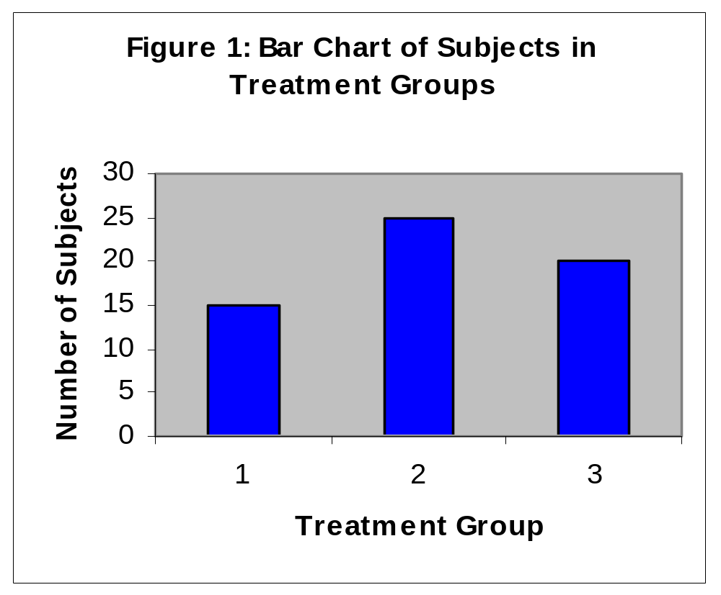
Data Presentation –Categorical Variable
Bar Diagram: Lists the categories and presents the percent or count of individuals who fall in each category.
Treatment Group | Frequency | Proportion | Percent (%)
1 | 15 | (15/60)=0.25 | 25.0
2 | 25 | (25/60)=0.333 | 41.7
3 | 20 | (20/60)=0.417 | 33.3
Total | 60 | 1.00 | 100
Faculty Name: Mr. Hariprasath K Program Name: B.Tech CSE

Slide 13
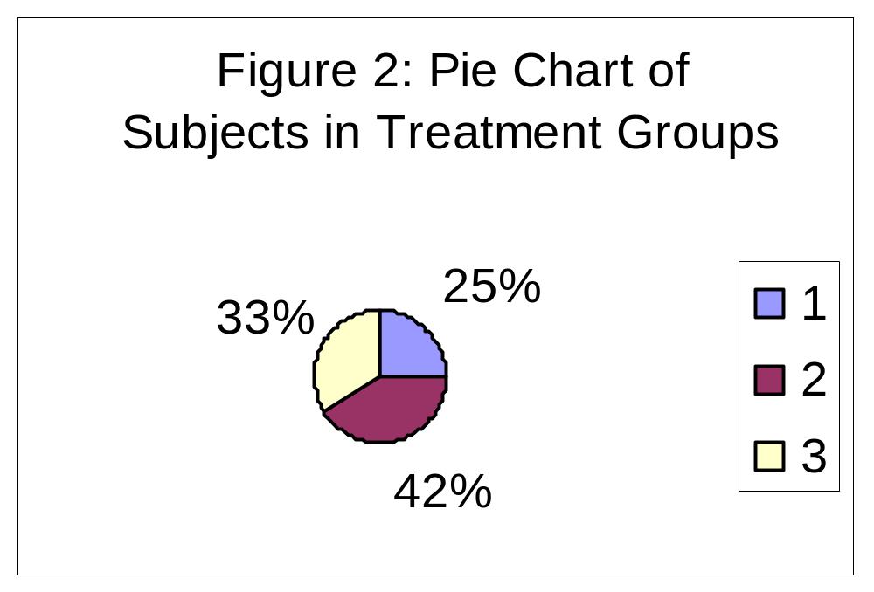
Data Presentation –Categorical Variable
Pie Chart: Lists the categories and presents the percent or count of individuals who fall in each category.
Treatment Group | Frequency | Proportion | Percent (%)
1 | 15 | (15/60)=0.25 | 25.0
2 | 25 | (25/60)=0.333 | 41.7
3 | 20 | (20/60)=0.417 | 33.3
Total | 60 | 1.00 | 100
Faculty Name: Mr. Hariprasath K Program Name: B.Tech CSE

Slide 14
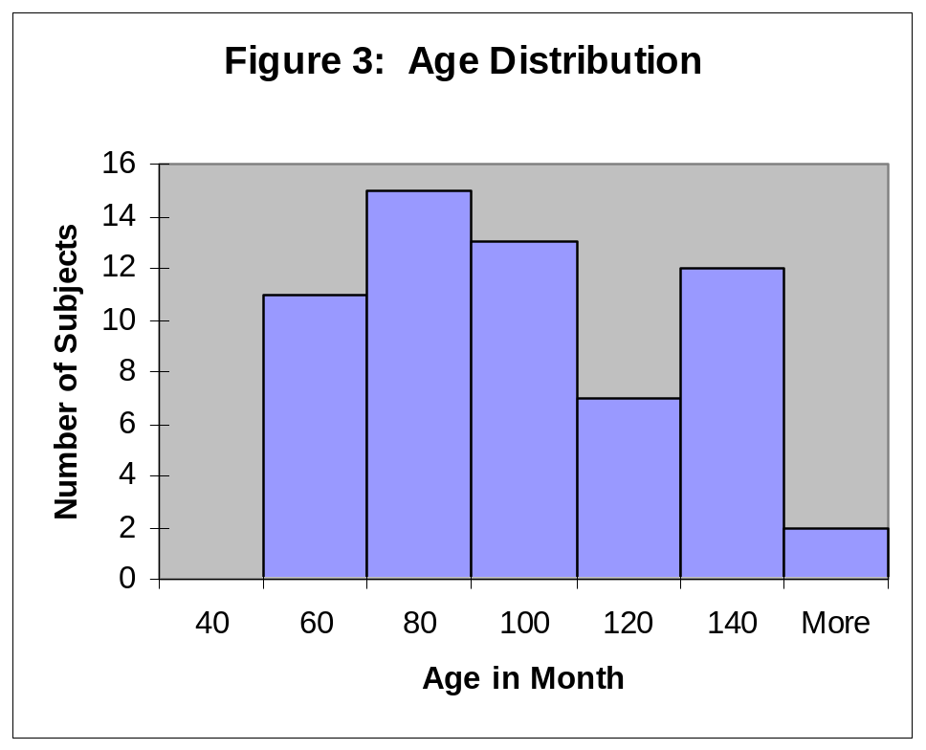
Graphical Presentation –Numerical Variable
Histogram: Overall pattern can be described by its shape, center, and spread. The following age distribution is right skewed. The center lies between 80 to 100. No outliers.
Mean | 90.41666667
Standard Error | 3.902649518
Median | 84
Mode | 84
Standard Deviation | 30.22979318
Sample Variance | 913.8403955
Kurtosis | -1.183899591
Skewness | 0.389872725
Range | 95
Minimum | 48
Maximum | 143
Sum | 5425
Count | 60
Faculty Name: Mr. Hariprasath K Program Name: B.Tech CSE

Slide 15
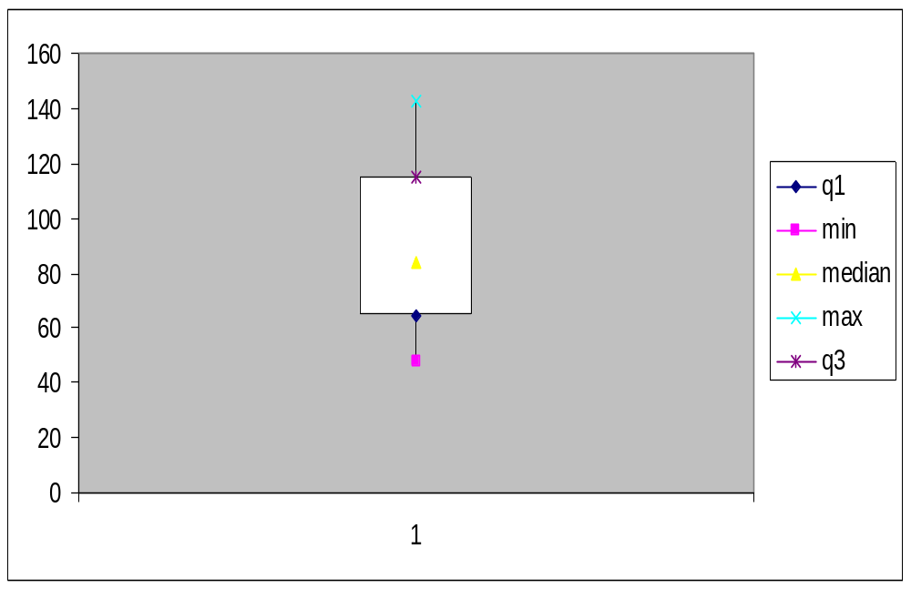
Graphical Presentation –Numerical Variable
Box-Plot: Describes the five-number summary
Figure 3: Distribution of Age
Box Plot
Faculty Name: Mr. Hariprasath K Program Name: B.Tech CSE

Slide 16
Numerical Presentation
A fundamental concept in summary statistics is that of a central value for a set of observations and the extent to which the central value characterizes the whole set of data. Measures of central value such as the mean or median must be coupled with measures of data dispersion (e.g., average distance from the mean) to indicate how well the central value characterizes the data as a whole.
To understand how well a central value characterizes a set of observations, let us consider the following two sets of data:
  A: 30, 50, 70
  B: 40, 50, 60
The mean of both two data sets is 50. But, the distance of the observations from the mean in data set A is larger than in the data set B. Thus, the mean of data set B is a better representation of the data set than is the case for set A.
Faculty Name: Mr. Hariprasath K Program Name: B.Tech CSE

Slide 17
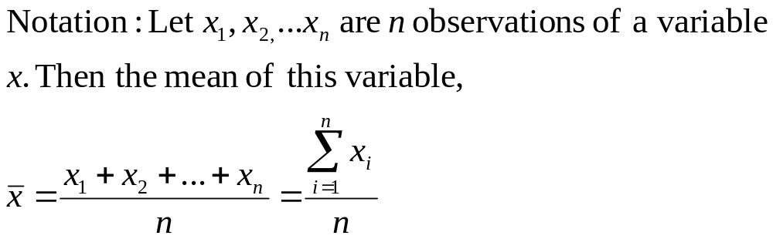
Methods of Center Measurement
Center measurement is a summary measure of the overall level of a dataset
Commonly used methods are mean, median, mode, geometric mean etc.
Mean: Summing up all the observation and dividing by number of observations. Mean of 20, 30, 40 is (20+30+40)/3 = 30.
Faculty Name: Mr. Hariprasath K Program Name: B.Tech CSE

Slide 18
Methods of Center Measurement
Median: The middle value in an ordered sequence of observations. That is, to find the median we need to order the data set and then find the middle value. In case of an even number of observations the average of the two middle most values is the median.
For example, to find the median of {9, 3, 6, 7, 5}, we first sort the data giving {3, 5, 6, 7, 9}, then choose the middle value 6. If the number of observations is even, e.g., {9, 3, 6, 7, 5, 2}, then the median is the average of the two middle values from the sorted sequence, in this case, (5 + 6) / 2 = 5.5.
Mode: The value that is observed most frequently. The mode is undefined for sequences in which no observation is repeated.
Faculty Name: Mr. Hariprasath K Program Name: B.Tech CSE

Slide 19
Mean or Median
The median is less sensitive to outliers (extreme scores) than the mean and thus a better measure than the mean for highly skewed distributions, e.g. family income.
For example mean of 20, 30, 40, and 990 is (20+30+40+990)/4 =270.
The median of these four observations is (30+40)/2 =35.
Here 3 observations out of 4 lie between 20-40.
So, the mean 270 really fails to give a realistic picture of the major part of the data.
It is influenced by extreme value 990.
Faculty Name: Mr. Hariprasath K Program Name: B.Tech CSE

Slide 20
Methods of Variability Measurement
Variability (or dispersion) measures the amount of scatter in a dataset.
Commonly used methods: range, variance, standard deviation, interquartile range, coefficient of variation etc.
Range:
The difference between the largest and the smallest observations.
The range of 10, 5, 2, 100 is (100-2)=98.
It’s a crude measure of variability.
Faculty Name: Mr. Hariprasath K Program Name: B.Tech CSE

Slide 21
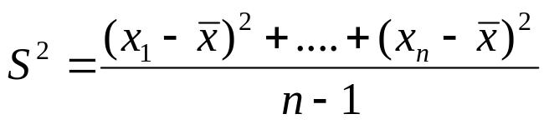
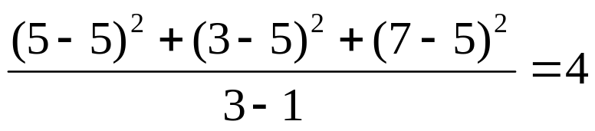
Methods of Variability Measurement
Variance: The variance of a set of observations is the average of the squares of the deviations of the observations from their mean. In symbols, the variance of the n observations x₁, x₂,…x_{n} is
Variance of 5, 7, 3? Mean is (5+7+3)/3 = 5 and the variance is
Standard Deviation: Square root of the variance. The standard deviation of the above example is 2.
Faculty Name: Mr. Hariprasath K Program Name: B.Tech CSE

Slide 22
Variables – Revisiting…
A variable is a characteristic or condition that can change or take on different values.
Most research begins with a general question about the relationship between two variables for a specific group of individuals.
Faculty Name: Mr. Hariprasath K Program Name: B.Tech CSE

Slide 23
Population
The entire group of individuals is called the population.
For example, a researcher may be interested in the relation between class size (variable 1) and academic performance (variable 2) for the population of third-grade children.
Faculty Name: Mr. Hariprasath K Program Name: B.Tech CSE

Slide 24
Sample
Usually populations are so large that a researcher cannot examine the entire group.
Therefore, a sample is selected to represent the population in a research study.
The goal is to use the results obtained from the sample to help answer questions about the population.
Faculty Name: Mr. Hariprasath K Program Name: B.Tech CSE

Slide 25
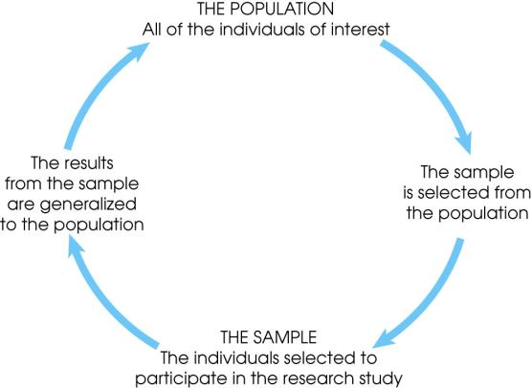
Faculty Name: Mr. Hariprasath K Program Name: B.Tech CSE
Notes:
Figure 1.1
The relationship between a population and a sample.

Slide 26
Types of Variables
Variables can be classified as discrete or continuous.
Discrete variables (such as class size) consist of indivisible categories
continuous variables (such as time or weight) are infinitely divisible into whatever units a researcher may choose.
For example, time can be measured to the nearest minute, second, half-second, etc.
Faculty Name: Mr. Hariprasath K Program Name: B.Tech CSE

Slide 27
Real Limits
To define the units for a continuous variable, a researcher must use real limits which are boundaries located exactly half-way between adjacent categories.
Faculty Name: Mr. Hariprasath K Program Name: B.Tech CSE

Slide 28
Measuring Variables
To establish relationships between variables, researchers must observe the variables and record their observations. This requires that the variables be measured.
The process of measuring a variable requires a set of categories called a scale of measurement and a process that classifies each individual into one category.
Faculty Name: Mr. Hariprasath K Program Name: B.Tech CSE

Slide 29
4 Types of Measurement Scales
A nominal scale is an unordered set of categories identified only by name. Nominal measurements only permit you to determine whether two individuals are the same or different.
An ordinal scale is an ordered set of categories. Ordinal measurements tell you the direction of difference between two individuals.
An interval scale is an ordered series of equal-sized categories. Interval measurements identify the direction and magnitude of a difference. The zero point is located arbitrarily on an interval scale.
A ratio scale is an interval scale where a value of zero indicates none of the variable. Ratio measurements identify the direction and magnitude of differences and allow ratio comparisons of measurements.
Faculty Name: Mr. Hariprasath K Program Name: B.Tech CSE

Slide 30
Correlational Studies
The goal of a correlational study is to determine whether there is a relationship between two variables and to describe the relationship.
A correlational study simply observes the two variables as they exist naturally.
Faculty Name: Mr. Hariprasath K Program Name: B.Tech CSE

Slide 31
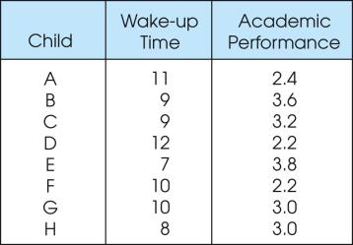
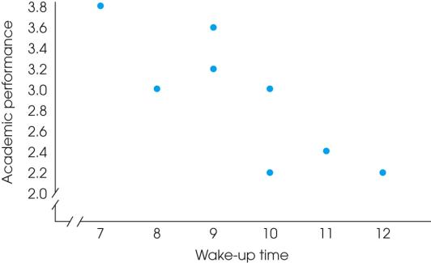
Faculty Name: Mr. Hariprasath K Program Name: B.Tech CSE
Notes:
Figure 1.4
One of two data structures for studies evaluating the relationship between variables. Note that there are two separate measurements for each individual (wake-up time and academic performance). The same scores are shown in a table (a) and in a graph (b).

Slide 32
Experiments
The goal of an experiment is to demonstrate a cause-and-effect relationship between two variables; that is, to show that changing the value of one variable causes changes to occur in a second variable.
Faculty Name: Mr. Hariprasath K Program Name: B.Tech CSE

Slide 33
Experiments (cont.)
In an experiment, one variable is manipulated to create treatment conditions. A second variable is observed and measured to obtain scores for a group of individuals in each of the treatment conditions.
The measurements are then compared to see if there are differences between treatment conditions. All other variables are controlled to prevent them from influencing the results.
In an experiment, the manipulated variable is called the independent variable and the observed variable is the dependent variable.
Faculty Name: Mr. Hariprasath K Program Name: B.Tech CSE

Slide 34
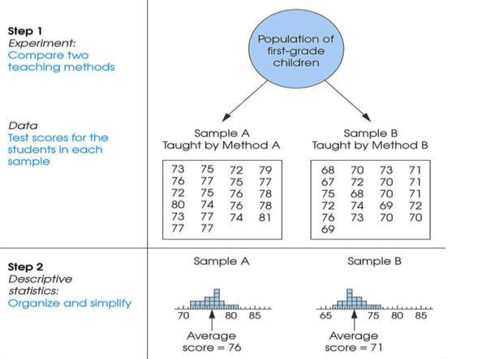
Faculty Name: Mr. Hariprasath K Program Name: B.Tech CSE
Notes:
Figure 1.3
The role of statistics in experimental research.

Slide 35
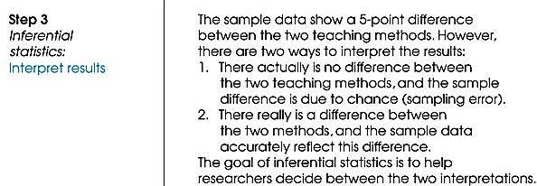
Faculty Name: Mr. Hariprasath K Program Name: B.Tech CSE
Notes:
Figure 1.3
The role of statistics in experimental research.

Slide 36
Other Types of Studies
Other types of research studies, know as non-experimental or quasi-experimental, are similar to experiments because they also compare groups of scores.
These studies do not use a manipulated variable to differentiate the groups. Instead, the variable that differentiates the groups is usually a pre-existing participant variable (such as male/female) or a time variable (such as before/after).
Because these studies do not use the manipulation and control of true experiments, they cannot demonstrate cause and effect relationships.As a result, they are similar to correlational research because they simply demonstrate and describe relationships.
Faculty Name: Mr. Hariprasath K Program Name: B.Tech CSE

Slide 37
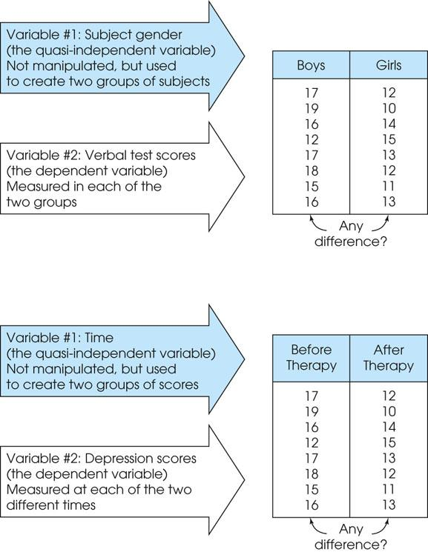
Faculty Name: Mr. Hariprasath K Program Name: B.Tech CSE
Notes:
Figure 1.7
Two examples of nonexperimental studies that involve comparing two groups of scores. In (a) the study uses two preexisting groups (boys/girls) and measures a dependent variable (verbal scores) in each group. In (b) the study uses time (before/after) to define the two groups and measures a dependent variable (depression) in each group.

Slide 38
Faculty Name: Mr. Hariprasath K Program Name: B.Tech CSE
Notes:
Figure 1.7
Two examples of nonexperimental studies that involve comparing two groups of scores. In (a) the study uses two preexisting groups (boys/girls) and measures a dependent variable (verbal scores) in each group. In (b) the study uses time (before/after) to define the two groups and measures a dependent variable (depression) in each group.

Slide 39
Data
The measurements obtained in a research study are called the data.
The goal of statistics is to help researchers organize and interpret the data.
Faculty Name: Mr. Hariprasath K Program Name: B.Tech CSE

Slide 40
Descriptive Statistics
Descriptive statistics are methods for organizing and summarizing data.
For example, tables or graphs are used to organize data, and descriptive values such as the average score are used to summarize data.
A descriptive value for a population is called a parameter and a descriptive value for a sample is called a statistic.
Faculty Name: Mr. Hariprasath K Program Name: B.Tech CSE

Slide 41
Inferential Statistics
Inferential statistics are methods for using sample data to make general conclusions (inferences) about populations.
Because a sample is typically only a part of the whole population, sample data provide only limited information about the population. As a result, sample statistics are generally imperfect representatives of the corresponding population parameters.
Faculty Name: Mr. Hariprasath K Program Name: B.Tech CSE

Slide 42
Sampling Error
The discrepancy between a sample statistic and its population parameter is called sampling error.
Defining and measuring sampling error is a large part of inferential statistics.
Faculty Name: Mr. Hariprasath K Program Name: B.Tech CSE

Slide 43
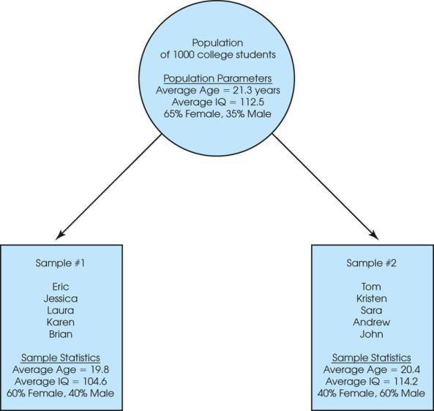
Notes:
Figure 1.2
A demonstration of sampling error. Two samples are selected from the same population. Notice that the sample statistics are different from one sample to another, and all of the sample statistics are different from the corresponding population parameters. The natural differences that exist, by chance, between a sample statistic and a population parameter are called sampling error.

Slide 44
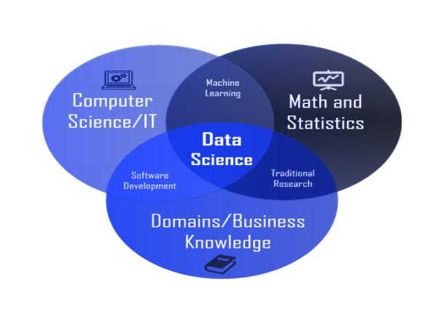
Data Science: What is?
Faculty Name: Mr. Hariprasath K Program Name: B.Tech CSE

Slide 45
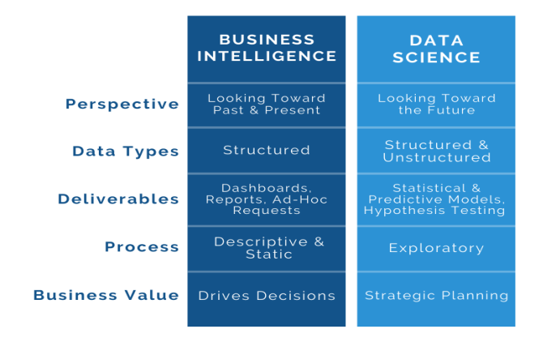
BI and Data Science
Faculty Name: Mr. Hariprasath K Program Name: B.Tech CSE

Slide 46
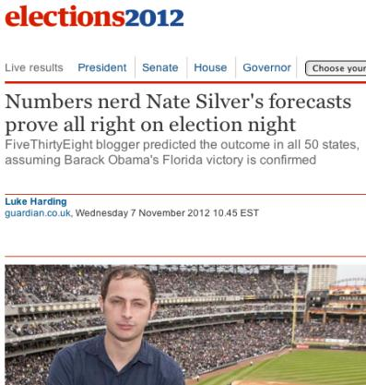
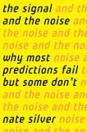
Data Science: Why all the Excitement?
Faculty Name: Mr. Hariprasath K Program Name: B.Tech CSE

Slide 47




Data All Around
Lots of data is being collected
and warehoused
  Web data, e-commerce
  Financial transactions, bank/credit transactions
  Online trading and purchasing
  Social Network
Faculty Name: Mr. Hariprasath K Program Name: B.Tech CSE

Slide 48







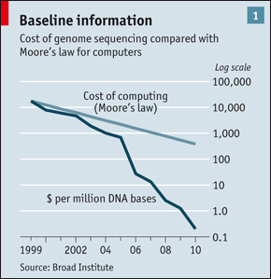
“Big Data” Sources
It’s All Happening On-line
User Generated (Web & Mobile)
Every:
Click
Ad impression
Billing event
Fast Forward, pause,…
Server request
Transaction
Network message
Fault
…
…..
Internet of Things / M2M
Health/Scientific Computing

Slide 49
Types of Data We Have
Relational Data (Tables/Transaction/Legacy Data)
Text Data (Web)
Semi-structured Data (XML)
Graph Data
Social Network, Semantic Web (RDF), …
Streaming Data
You can afford to scan the data once
Faculty Name: Mr. Hariprasath K Program Name: B.Tech CSE

Slide 50
What To Do With These Data?
Aggregation and Statistics
  Data warehousing and OLAP
Indexing, Searching, and Querying
  Keyword based search
  Pattern matching (XML/RDF)
Knowledge discovery
  Data Mining
  Statistical Modeling
Faculty Name: Mr. Hariprasath K Program Name: B.Tech CSE

Slide 51
Big Data and Data Science
“… the sexy job in the next 10 years will be statisticians,” Hal Varian, Google Chief Economist
The U.S. will need 140,000-190,000 predictive analysts and 1.5 million managers/analysts by 2018. McKinsey Global Institute’s June 2011
New Data Science institutes being created or repurposed – NYU, Columbia, Washington, UCB,...
New degree programs, courses, boot-camps:
  e.g., at Berkeley: Stats, I-School, CS, Astronomy…
  One proposal (elsewhere) for an MS in “Big Data Science”
Faculty Name: Mr. Hariprasath K Program Name: B.Tech CSE

Slide 52
What is Data Science?
An area that manages, manipulates, extracts, and interprets knowledge from tremendous amount of data
Data science (DS) is a multidisciplinary field of study with goal to address the challenges in big data
Data science principles apply to all data – big and small
https://hbr.org/2012/10/data-scientist-the-sexiest-job-of-the-21st-century/
Faculty Name: Mr. Hariprasath K Program Name: B.Tech CSE

Slide 53
What is Data Science?
Theories and techniques from many fields and disciplines are used to investigate and analyze a large amount of data to help decision makers in many industries such as science, engineering, economics, politics, finance, and education
  Computer Science
    Pattern recognition, visualization, data warehousing, High performance computing, Databases, AI
  Mathematics
    Mathematical Modeling
  Statistics
    Statistical and Stochastic modeling, Probability.
Faculty Name: Mr. Hariprasath K Program Name: B.Tech CSE

Slide 54
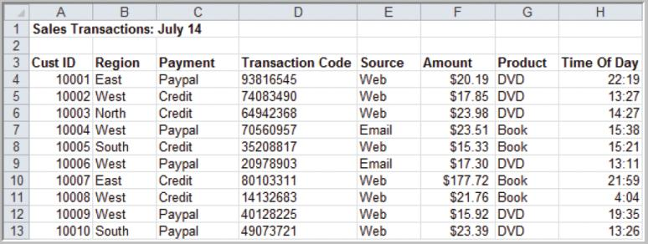
Example: A Sales Transaction Database File
Records
Entities
Fields or Attributes
Faculty Name: Mr. Hariprasath K Program Name: B.Tech CSE

Slide 55
Types Data Based on Measurement Scale
Categorical (nominal) data
Ordinal data
Interval data
Ratio data
Faculty Name: Mr. Hariprasath K Program Name: B.Tech CSE

Slide 56
Categorical (nominal) Data
Data placed in categories according to a specified characteristic
Categories bear no quantitative relationship to one another
Examples:
- customer’s location (America, Europe, Asia)
- employee classification (manager, supervisor,
associate)
Faculty Name: Mr. Hariprasath K Program Name: B.Tech CSE

Slide 57
Ordinal Data
Data that is ranked or ordered according to some relationship with one another
No fixed units of measurement
Examples:
- college football rankings
- survey responses
(poor, average, good, very good, excellent)
Faculty Name: Mr. Hariprasath K Program Name: B.Tech CSE

Slide 58
Interval Data
Ordinal data but with constant differences between observations
No true zero point
Ratios are not meaningful
Examples:
- temperature readings
- SAT scores
Faculty Name: Mr. Hariprasath K Program Name: B.Tech CSE

Slide 59
Ratio Data
Continuous values and have a natural zero point
Ratios are meaningful
Examples:
- monthly sales
- delivery times
Faculty Name: Mr. Hariprasath K Program Name: B.Tech CSE

Slide 60
Types Of Data
Structured
Unstructured
Semi-structured
Faculty Name: Mr. Hariprasath K Program Name: B.Tech CSE

Slide 61
Structured Data
Structured data is data whose elements are addressable for effective analysis. It has been organized into a formatted repository that is typically a database.
It concerns all data which can be stored in database SQL in a table with rows and columns. They have relational keys and can easily be mapped into pre-designed fields. Today, those data are most processed in the development and simplest way to manage information.
Example: Relational data.
Faculty Name: Mr. Hariprasath K Program Name: B.Tech CSE

Slide 62
Semi-Structured data
Semi-structured data is information that does not reside in a relational database but that have some organizational properties that make it easier to analyze. With some process, you can store them in the relation database (it could be very hard for some kind of semi-structured data), but Semi-structured exist to ease space. Example: XML data.
Faculty Name: Mr. Hariprasath K Program Name: B.Tech CSE

Slide 63
Unstructured data
Unstructured data is a data that is which is not organized in a pre-defined manner or does not have a pre-defined data model, thus it is not a good fit for a mainstream relational database.
So for Unstructured data, there are alternative platforms for storing and managing, it is increasingly prevalent in IT systems and is used by organizations in a variety of business intelligence and analytics applications. Example: Word, PDF, Text, Media logs.
Faculty Name: Mr. Hariprasath K Program Name: B.Tech CSE

Slide 64
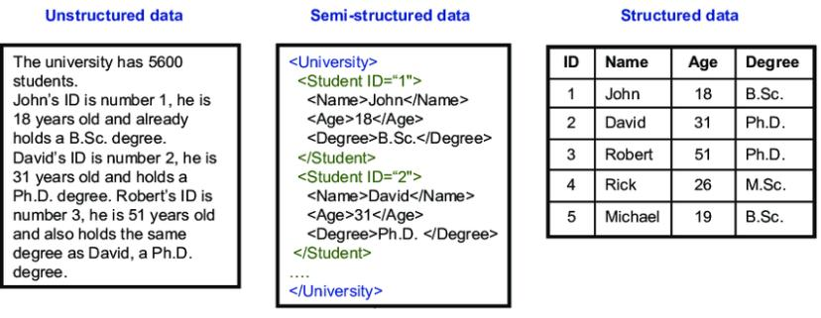
Faculty Name: Mr. Hariprasath K Program Name: B.Tech CSE

Slide 65
Big Data
Big Data is also data but with a huge size. Big Data is a term used to describe a collection of data that is huge in size and yet growing exponentially with time.
In short such data is so large and complex that none of the traditional data management tools are able to store it or process it efficiently.
Faculty Name: Mr. Hariprasath K Program Name: B.Tech CSE

Slide 66
Big Data Definition
No single standard definition…
“Big Data” is data whose scale, diversity, and complexity require new architecture, techniques, algorithms, and analytics to manage it and extract value and hidden knowledge from it…
Faculty Name: Mr. Hariprasath K Program Name: B.Tech CSE

Slide 67
The V's of Big Data
Velocity
Volume
Value
Variety
Veracity
Faculty Name: Mr. Hariprasath K Program Name: B.Tech CSE

Slide 68
Velocity
First let’s talk about velocity. Obviously, velocity refers to the speed at which vast amounts of data are being generated, collected and analyzed.
Every day the number of emails, twitter messages, photos, video clips, etc. increases at lighting speeds around the world.
Every second of every day data is increasing.
Faculty Name: Mr. Hariprasath K Program Name: B.Tech CSE

Slide 69
Velocity
Not only must it be analyzed, but the speed of transmission, and access to the data must also remain instantaneous to allow for real-time access to website, credit card verification and instant messaging.
Big data technology allows us now to analyze the data while it is being generated, without ever putting it into databases.
Faculty Name: Mr. Hariprasath K Program Name: B.Tech CSE

Slide 70
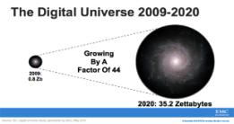
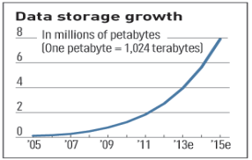
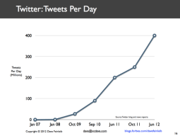
Volume
Data Volume
  44x increase from 2009 2020
  From 0.8 zettabytes to 35zb
Data volume is increasing exponentially
Exponential increase in collected/generated data
Faculty Name: Mr. Hariprasath K Program Name: B.Tech CSE

Slide 71
Value
When we talk about value, we’re referring to the worth of the data being extracted.
Having endless amounts of data is one thing, but unless it can be turned into value it is useless.
The most important part of embarking on a big data initiative is to understand the costs and benefits of collecting and analyzing the data to ensure that ultimately the data that is reaped can be monetized.
Faculty Name: Mr. Hariprasath K Program Name: B.Tech CSE

Slide 72
Variety
Variety is defined as the different types of data we can now use.
Data today looks very different than data from the past.
We no longer just have structured data (name, phone number, address, financials, etc) that fits nice and neatly into a data table.
Today’s data is unstructured. In fact, 80% of all the world’s data fits into this category, including photos, video sequences, social media updates, etc.
New and innovative big data technology is now allowing structured and unstructured data to be harvested, stored, and used simultaneously.
Faculty Name: Mr. Hariprasath K Program Name: B.Tech CSE

Slide 73
Variety
Relational Data (Tables/Transaction/Legacy Data)
Text Data (Web)
Semi-structured Data (XML)
Graph Data
  Social Network, Semantic Web (RDF), …
Streaming Data
  You can only scan the data once
A single application can be generating/collecting many types of data
Big Public Data (online, weather, finance, etc)
To extract knowledge➔ all these types of data need to linked together
Faculty Name: Mr. Hariprasath K Program Name: B.Tech CSE

Slide 74
Veracity
Veracity is the quality or trustworthiness of the data. Just how accurate is all this data?
  For example, think about all the Twitter posts with hash tags, abbreviations, typos, etc., and the reliability and accuracy of all that content. Gleaning loads and loads of data is of no use if the quality or trustworthiness is not accurate.
  Another good example of this relates to the use of GPS data. Often the GPS will “drift” off course as you peruse through an urban area. Satellite signals are lost as they bounce off tall buildings or other structures. When this happens, location data has to be fused with another data source like road data, or data from an accelerometer to provide accurate data.
Faculty Name: Mr. Hariprasath K Program Name: B.Tech CSE

Slide 75
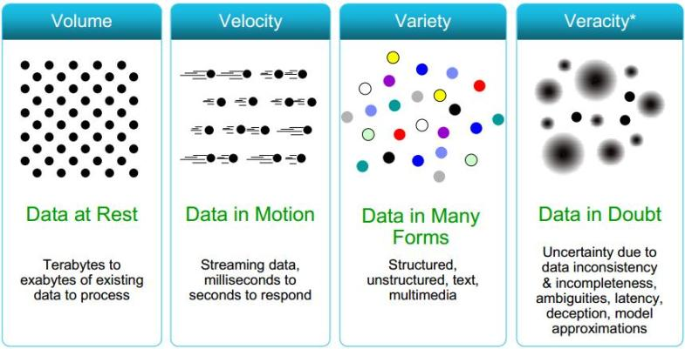
Faculty Name: Mr. Hariprasath K Program Name: B.Tech CSE

Slide 76










Who’s Generating Big Data
Social media and networks
(all of us are generating data)
Scientific instruments
(collecting all sorts of data)
Mobile devices
(tracking all objects all the time)
Sensor technology and networks
(measuring all kinds of data)
Faculty Name: Mr. Hariprasath K Program Name: B.Tech CSE

Slide 77




The Model Has Changed…
The Model of Generating/Consuming Data has Changed
Old Model: Few companies are generating data, all others are consuming data
New Model: all of us are generating data, and all of us are consuming data
Faculty Name: Mr. Hariprasath K Program Name: B.Tech CSE

Slide 78
Insights in Data Science
Data Science is the area of study which involves extracting insights from vast amounts of data by the use of various scientific methods, algorithms, and processes. It helps you to discover hidden patterns from the raw data.
The term Data Science has emerged because of the evolution of mathematical statistics, data analysis, and big data.
Data Science is an interdisciplinary field that allows you to extract knowledge from structured or unstructured data.
Data science enables you to translate a business problem into a research project and then translate it back into a practical solution.
Faculty Name: Mr. Hariprasath K Program Name: B.Tech CSE

Slide 79
Why Data Science?
Here, are significant advantages of using Data Analytics Technology:
  Data is the oil for today's world. With the right tools, technologies, algorithms, we can use data and convert it into a distinctive business advantage
  Data Science can help you to detect fraud using advanced machine learning algorithms
  It helps you to prevent any significant monetary losses
  Allows to build intelligence ability in machines
  You can perform sentiment analysis to gauge customer brand loyalty
  It enables you to take better and faster decisions
  Helps you to recommend the right product to the right customer to enhance your business
Faculty Name: Mr. Hariprasath K Program Name: B.Tech CSE

Slide 80
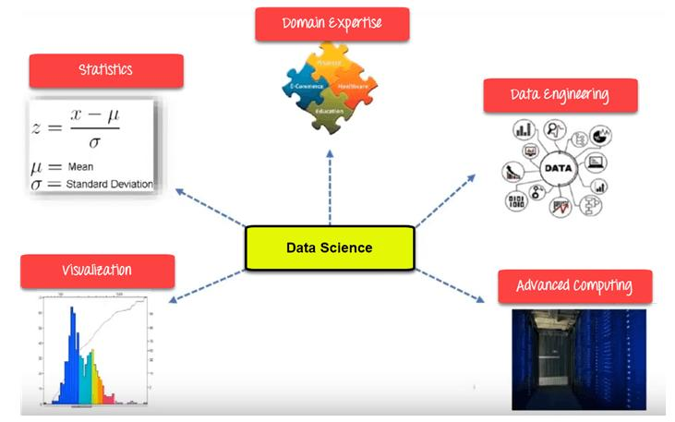
Data Science Components

Slide 81
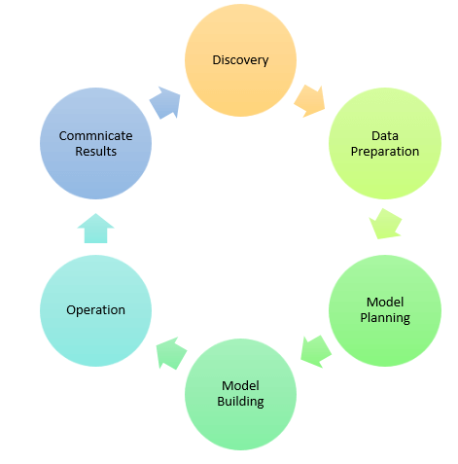
Data Science Process

Slide 82
The Data Science Lifecycle
Capture:
  Data Acquisition, Data Entry, Data Extraction.
  This stage involves gathering raw structured and unstructured data.
Maintain:
  Data Warehousing, Data Cleansing, Data Processing, Data Architecture.
  This stage covers taking the raw data and putting it in a form that can be used.
Process:
  Data Mining, Clustering/Classification, Data Modeling, Data Summarization.
  Data scientists take the prepared data and examine its patterns, ranges, and biases to determine how useful it will be in predictive analysis.

Slide 83
The Data Science Lifecycle
Analyze:
  Exploratory/Confirmatory, Predictive Analysis, Regression, Text Mining, Qualitative Analysis.
  This stage involves performing the various analyses on the data.
Communicate:
  Data Reporting, Data Visualization, Business Intelligence, Decision Making.
  In this final step, analysts prepare the analyses in easily readable forms such as charts, graphs, and reports.

Slide 84
Goal of Data Science
Turn data into data products.
Faculty Name: Mr. Hariprasath K Program Name: B.Tech CSE

Slide 85
How to use data?
Data => exploratory analysis => knowledge models => product / decision marking
Data => predictive models => evaluate / interpret => product / decision making
Faculty Name: Mr. Hariprasath K Program Name: B.Tech CSE

Slide 86
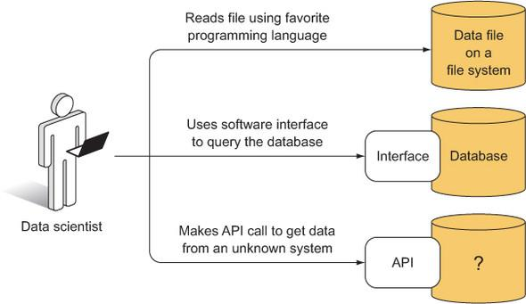
Three ways a data scientist might access data: from a file system, database, or API
Faculty Name: Mr. Hariprasath K Program Name: B.Tech CSE

Slide 87





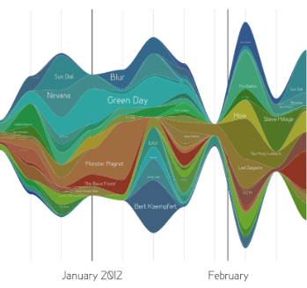
Data Scientist’s Practice
Clean,
prep
Hypothesize Model
Large Scale Exploitation
Digging Around
in Data
Evaluate
Interpret
Faculty Name: Mr. Hariprasath K Program Name: B.Tech CSE

Slide 88
Data Scientific Method
To get real truth and useful answers from data, we must use the scientific method, or in our case, the data scientific method:
Ask a question.
State a hypothesis about the answer to the question.
Make a testable prediction that would provide evidence in favor of the hypothesis if correct.
Test the prediction via an experiment involving data.
Draw the appropriate conclusions through analyses of experimental results.
Faculty Name: Mr. Hariprasath K Program Name: B.Tech CSE

Slide 89
Example data science applications
Marketing: predict the characteristics of high life time value (LTV) customers, which can be used to support customer segmentation, identify upsell opportunities, and support other marking initiatives
Logistics: forecast how many of which things you need and where will we need them, which enables learn inventory and prevents out of stock situations
Healthcare: analyze survival statistics for different patient attributes (age, blood type, gender, etc.) and treatments; predict risk of re-admittance based on patient attributes, medical history, etc.
Faculty Name: Mr. Hariprasath K Program Name: B.Tech CSE

Slide 90
More Examples
Transaction Databases → Recommender systems (NetFlix), Fraud Detection (Security and Privacy)
Wireless Sensor Data → Smart Home, Real-time Monitoring, Internet of Things
Text Data, Social Media Data → Product Review and Consumer Satisfaction (Facebook, Twitter, LinkedIn), E-discovery
Software Log Data → Automatic Trouble Shooting (Splunk)
Genotype and Phenotype Data → Epic, 23andme, Patient-Centered Care, Personalized Medicine
Faculty Name: Mr. Hariprasath K Program Name: B.Tech CSE

Slide 91
Statistics for Data Science
Statistics is one of the popularly known disciplines that is mainly focused on data collection, data organization, data analysis, data interpretation, and data visualization.
Earlier, statistics was practiced by statisticians, economists, business owners to calculate and represent relevant data in their field.

Slide 92
Basic Terminologies in Statistics
Population: A population is the set of resources from where we can collect data.
Sample: A Sample is nothing but a subset of the Population which is used for sampling of data and in inferential statistics to predict the outcome.
Variable: A Variable can be a number, a characteristic, or a quantity that can be counted. It can be also called a data point.
Probability Distribution: A probability distribution is a mathematical concept that primarily gives the probabilities of occurrence of different possible outcomes generally for an experiment conducted by statisticians.
Statistical Parameter: Statistical or population parameter is basically a quantity that helps in indexing a family of probability distributions like the mean, median, or mode of a population.

Slide 93
Example
You need to know the first-year student’s mean of money spent at XYZ College over the college supplies, excluding books. You randomly study 500 first-year students studying at your college. Three students spent $200, $150, and $225, sequentially. Check the term
Sample
Population
Data
Variable
Statistics
Parameter

Slide 94
Solution
Sample: 500 students of first-year who have studied at XYZ college.
Population: Total number of first-year students at XYZ College.
Data: $200, $150,and $225.
Variable: The sum of money of XYZ College a first-year student used on college supplies, excluding books.
Statistics: Average money the 500 college students used on college supplies, excluding books.
Parameter: Average money a college student used on college supplies, excluding books.

Slide 95
Statistics for Data Science
Types of Statistics Concepts:
Descriptive Statistics -Descriptive statistics is a concept that allows us to analyze and summarize data and organize the same in the form of numbers graph, bar plots, histogram, pie chart, etc.
Descriptive statistics is simply a process to describe our existing data.
It transforms the raw observations into some meaningful data that can be further interpreted and used.
Concepts like standard deviation, central tendency are widely used around the world when it comes to learning descriptive statistics.

Slide 96
Example
Measure of Location
Mean: Average of the given information. | Median: Center point of the collected data. | Mode: The most occurring value points.
 | Measure of Spread
Standard deviation: Deviation of the collected information in an experiment. | Interquartile Range: The difference between the 75% and 25% of the collected data. | Range: It is the difference value of the largest and smallest values.

Slide 97
Inferential Statistics
Inferential Statistics – Inferential statistics on the other hand is an important concept that deals with drawing conclusions based on small samples collected from the entire population.
For example, during an election poll, people will often want to predict the exit poll results so they will conduct a survey in various parts of state or country and record their opinion. Based on the information they have collected they tend to draw conclusions and make inferences to predict results for the entire population.

Slide 98
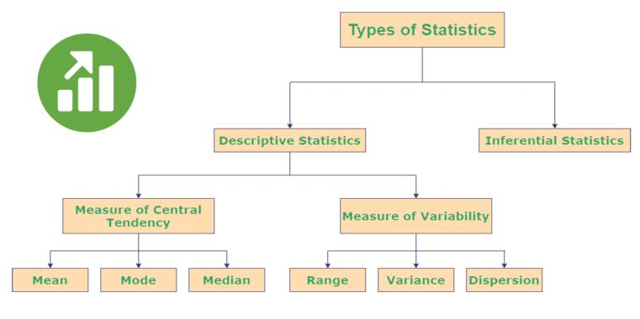
Types of Statistics

Slide 99
Central tendency
Mean: It is the central value which is commonly known as arithmetic average.
Mode: It refers to the value that appears most often in a data set.
Median: It is the middle value of the ordered set that divides it in exactly half.

Slide 100
Variability
Standard Deviation
  The Standard Deviation is a measure of how spread out numbers are.
  Its symbol is σ (the greek letter sigma)
  it is the square root of the Variance.
The Variance is defined as:
  The average of the squared differences from the Mean.

Slide 101
Example
The heights of dogs are: 600mm, 470mm, 170mm, 430mm and 300mm.Find out the Mean, the Variance, and the Standard Deviation.
Mean | = | 600 + 470 + 170 + 430 + 3005
 | = | 19705
 | = | 394

Slide 102
Example
Variance
σ² | = | 206² + 76² + (−224)² + 36² + (−94)²5
 | = | 42436 + 5776 + 50176 + 1296 + 88365
 | = | 1085205
 | = | 21704
Standard Deviation
σ | = | √21704
 | = | 147.32...
 | = | 147 (to the nearest mm)

Slide 103
Statistics for Data Science
Range: This is defined as the difference between the largest and smallest value of a dataset.
Percentile: It refers to the measure used in statistics that indicates the value below which the given percentage of observation in the dataset falls.
Quartile: It is defined as the value that divides the data points into quarters.
Interquartile Range: It measures the middle half of your data. In general terms, it is the middle 50% of the dataset.

Slide 104
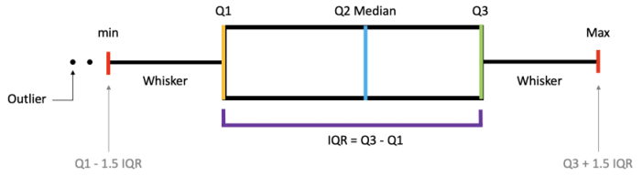
Variability
Range: The difference between the highest and lowest value in the dataset.
Quartiles and Interquartile Range (IQR)
Quantiles— Values that divide the number of data points into four more or less equal parts, or quarters.
Interquartile Range (IQR)— A measure of statistical dispersion and variability based on dividing a data set into quartiles. IQR = Q3 − Q1

Slide 105
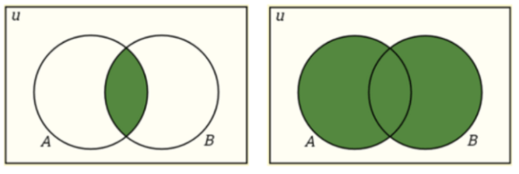
Probability
Probability is the measure of the likelihood that an event will occur in a Random Experiment.
Complement: P(A) + P(A’) = 1
Intersection: P(A∩B) = P(A)P(B)
Union: P(A∪B) = P(A) + P(B) − P(A∩B)
Program Name: B.Tech

Slide 106
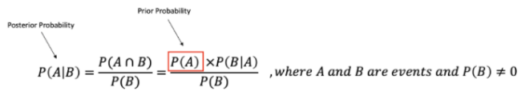
Probability
Conditional Probability: P(A|B) is a measure of the probability of one event occurring with some relationship to one or more other events. P(A|B)=P(A∩B)/P(B), when P(B)>0.
Independent Events: Two events are independent if the occurrence of one does not affect the probability of occurrence of the other. P(A∩B)=P(A)P(B) where P(A) != 0 and P(B) != 0 , P(A|B)=P(A), P(B|A)=P(B)
Mutually Exclusive Events: Two events are mutually exclusive if they cannot both occur at the same time. P(A∩B)=0 and P(A∪B)=P(A)+P(B).
Bayes’ Theorem describes the probability of an event based on prior knowledge of conditions that might be related to the event.
Program Name: B.Tech

Slide 107

Covariance
A quantitative measure of the joint variability between two or more variables.
It is a measure to show the extent to which given two random variables change with respect to each other.

Slide 108
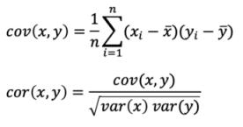
Correlation
Correlation shows the strength of a relationship between two variables and is expressed numerically by the correlation coefficient.
The correlation coefficient's values range between -1.0 and 1.0.
A perfect positive correlation means that the correlation coefficient is exactly 1.
A perfect negative correlation means that two assets move in opposite directions, while a zero correlation implies no linear relationship at all.

Slide 109
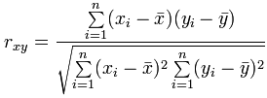
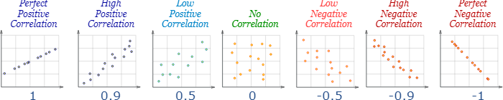
Correlation

Slide 110
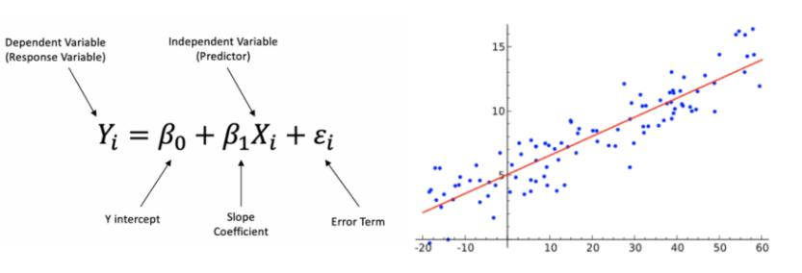
Regression
Linear Regression is a linear approach to modeling the relationship between a dependent variable and one independent variable. An independent variable is a variable that is controlled in a scientific experiment to test the effects on the dependent variable. A dependent variable is a variable being measured in a scientific experiment.
Program Name: B.Tech

Slide 111
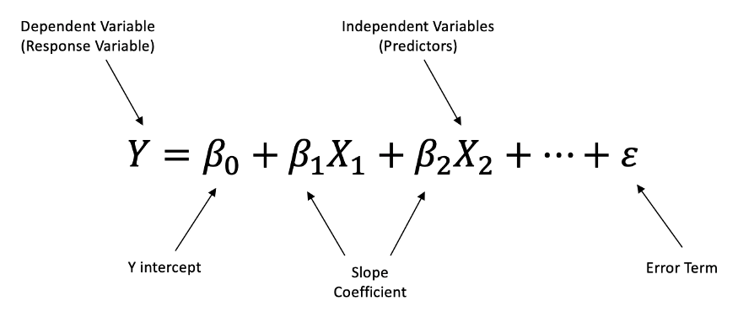
Regression
Multiple Linear Regression is a linear approach to modeling the relationship between a dependent variable and two or more independent variables.
Program Name: B.Tech

Slide 112
Understand the Type of Analytics
Descriptive Analytics tells us what happened in the past and helps a business understand how it is performing by providing context to help stakeholders interpret information.
Diagnostic Analytics takes descriptive data a step further and helps you understand why something happened in the past.
Predictive Analytics predicts what is most likely to happen in the future and provides companies with actionable insights based on the information.
Prescriptive Analytics provides recommendations regarding actions that will take advantage of the predictions and guide the possible actions toward a solution.

Slide 113
What is Business Analytics?
Analytics is the use of:
data,
information technology,
statistical analysis,
quantitative methods, and
mathematical or computer-based models
to help managers gain improved insight about their business operations and
make better, fact-based decisions.

Slide 114
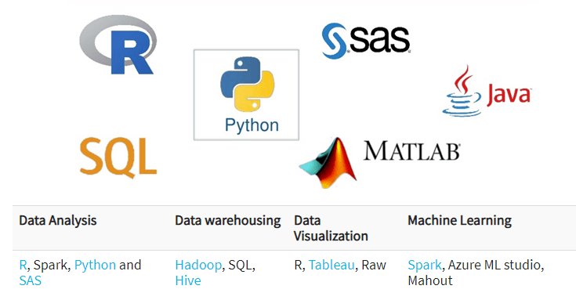
Tools for Data Science
Faculty Name: Mr. Hariprasath K Program Name: B.Tech CSE

Slide 115
Applications of Data Science
Healthcare
  Healthcare companies are using data science to build sophisticated medical instruments to detect and cure diseases.
Image Recognition
  Identifying patterns in images and detecting objects in an image is one of the most popular data science applications.
Recommendation Systems
  Netflix and Amazon give movie and product recommendations based on what you like to watch, purchase, or browse on their platforms.

Slide 116
Applications of Data Science
Logistics
  Data Science is used by logistics companies to optimize routes to ensure faster delivery of products and increase operational efficiency.
Fraud Detection
  Banking and financial institutions use data science and related algorithms to detect fraudulent transactions.
  Internet Search Results (Google)
  Intelligent Digital Assistants (Google Assistant)
  Autonomous Driving Vehicle (Waymo)
  Abusive Content and Hate Speech Filter (Facebook)
  Robotics (Boston Dynamics)

Slide 117
Challenges of Data science Technology
High variety of information & data is required for accurate analysis
Not adequate data science talent pool available
Management does not provide financial support for a data science team
Unavailability of/difficult access to data
Data Science results not effectively used by business decision makers
Explaining data science to others is difficult
Privacy issues
Lack of significant domain expert
If an organization is very small, they can't have a Data Science team
Faculty Name: Mr. Hariprasath K Program Name: B.Tech CSE

Slide 118
What is a Data Scientist?
Data scientists are among the most recent analytical data professionals who have the technical ability to handle complicated issues as well as the desire to investigate what questions need to be answered.
They're a mix of mathematicians, computer scientists, and trend forecasters.
On a daily basis, a data scientist may do the following tasks:
  Discover patterns and trends in datasets to get insights.
  Create forecasting algorithms and data models.
  Improve the quality of data or product offerings by utilizing machine learning techniques.
  In data analysis, use data tools such as R, SAS, Python, or SQL.

Slide 119
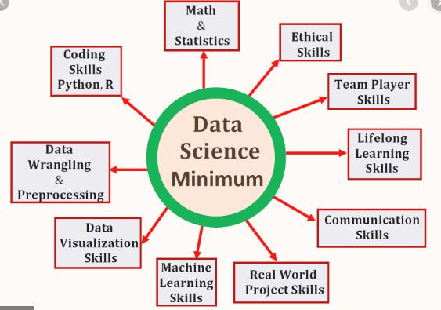
Essential skills for a data scientist
Faculty Name: Mr. Hariprasath K Program Name: B.Tech CSE

Slide 120
Data Wrangling
Data wrangling—also called data cleaning, data remediation, or data munging—refers to a variety of processes designed to transform raw data into more readily used formats. The exact methods differ from project to project depending on the data you’re leveraging and the goal you’re trying to achieve.

Slide 121
Data Wrangling
Some examples of data wrangling include:
Merging multiple data sources into a single dataset for analysis
Identifying gaps in data (for example, empty cells in a spreadsheet) and either filling or deleting them
Deleting data that’s either unnecessary or irrelevant to the project you’re working on
Identifying extreme outliers in data and either explaining the discrepancies or removing them so that analysis can take place

Slide 122
Data Wrangling Steps
DATA WRANGLING STEPS
Discovery
Structuring
Cleaning
Enriching
Validating
Publishing

Slide 123
Data Wrangling Steps
Discovery
Discovery refers to the process of familiarizing yourself with data so you can conceptualize how you might use it.
During discovery, you may identify trends or patterns in the data, along with obvious issues, such as missing or incomplete values that need to be addressed. This is an important step, as it will inform every activity that comes afterward.

Slide 124
Data Wrangling Steps
2. Structuring
Raw data is typically unusable in its raw state because it’s either incomplete or misformatted for its intended application.
Data structuring is the process of taking raw data and transforming it to be more readily leveraged. The form your data takes will depend on the analytical model you use to interpret it.

Slide 125
Data Wrangling Steps
3. Cleaning
Data cleaning is the process of removing inherent errors in data that might distort your analysis or render it less valuable.
Cleaning can come in different forms, including deleting empty cells or rows, removing outliers, and standardizing inputs.
The goal of data cleaning is to ensure there are no errors (or as few as possible) that could influence your final analysis.

Slide 126
Data Wrangling Steps
4. Enriching
Once you understand your existing data and have transformed it into a more usable state, you must determine whether you have all of the data necessary for the project at hand.
If not, you may choose to enrich or augment your data by incorporating values from other datasets. For this reason, it’s important to understand what other data is available for use.
If you decide that enrichment is necessary, you need to repeat the steps above for any new data.

Slide 127
Data Wrangling Steps
5. Validating
Data validation refers to the process of verifying that your data is both consistent and of a high enough quality.
During validation, you may discover issues you need to resolve or conclude that your data is ready to be analyzed.
Validation is typically achieved through various automated processes and requires programming.

Slide 128
Data Wrangling Steps
6. Publishing
Once your data has been validated, you can publish it. This involves making it available to others within your organization for analysis.
The format you use to share the information—such as a written report or electronic file—will depend on your data and the organization’s goals.

Slide 129
IMPORTANCE OF DATA WRANGLING
Making raw data usable. Accurately wrangled data guarantees that quality data is entered into the downstream analysis.
Getting all data from various sources into a centralized location so it can be used.
Piecing together raw data according to the required format and understanding the business context of data.
Automated data integration tools are used as data wrangling techniques that clean and convert source data into a standard format that can be used repeatedly according to end requirements. Businesses use this standardized data to perform crucial, cross-data set analytics.

Slide 130
IMPORTANCE OF DATA WRANGLING
Cleansing the data from the noise or flawed, missing elements.
Data wrangling acts as a preparation stage for the data mining process, which involves gathering data and making sense of it.
Helping business users make concrete, timely decisions.

Slide 131
Data Wrangling Formats
Transactional data:
  Transactional data refers to business operation transactions.
  This data type involves detailed subjective information about particular transactions, including client documentation, client interactions, receipts, and notes regarding any external transactions.
Analytical Base Table (ABT):
  Analytical Base Table data involves data within a table with unique entries for each attribute column.
  ABT data is the most common business data type as it involves various data types that contribute to the most common data sources.
  Even more notable is that ABT data is primarily used for AI and ML, which we will examine later.

Slide 132
Data Wrangling Formats
Time-series:
  Time series data involves data that has been divided by a particular amount of time or data that has a relation with time, particularly sequential time.
  For example, tracking data regarding an application's downloads over a year or tracking traffic data over a month would be considered time series data.
Document library:
  Lastly, document library data is information that involves a large amount of textual data, particularly text within a document. While document libraries contain rather massive amounts of data, automated data mining tools specifically designed for text mining can help extract entire texts from documents for further analysis.

Slide 133
Python Installation steps for data science.
Install Anaconda
Open Jupyter Notebook
Start New Notebook
Try Math Calculations
Import Data Science Libraries
https://elitedatascience.com/python-quickstart

Slide 134
Install Anaconda
We strongly recommend installing the Anaconda Distribution, which includes Python, Jupyter Notebook (a lightweight IDE very popular among data scientists), and all the major libraries.
It’s the closest thing to a one-stop-shop for all your setup needs.
Simply download Anaconda with the latest version of Python 3 and follow the wizard:

Slide 135
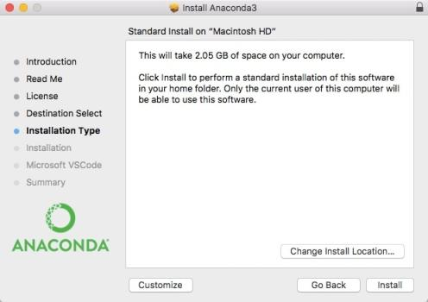
Install Anaconda

Slide 136
Open Jupyter Notebook
Jupyter Notebook is our favorite IDE (integrated development environment) for data science in Python. An IDE is just a fancy name for an advanced text editor for coding.
(As an analogy, think of Excel as an “IDE for spreadsheets.” For example, it has tabs, plugins, keyboard shortcuts, and other useful extras.)

Slide 137
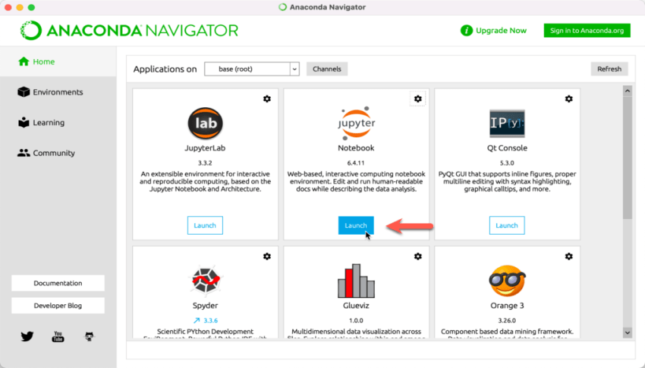
Open Jupyter Notebook

Slide 138
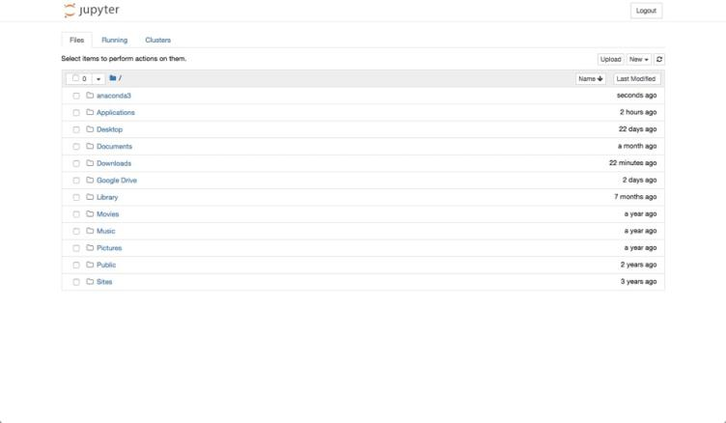
Open Jupyter Notebook

Slide 139
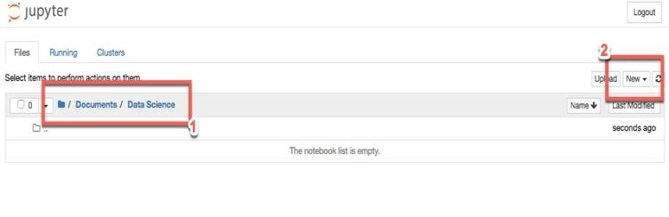
Open New Notebook

Slide 140
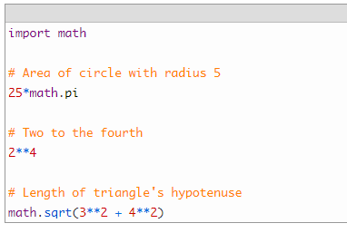
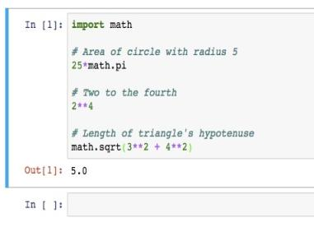
Try Math Calculations

Slide 141
Import Data Science Libraries
First, we imported the Pandas library. We also gave it the alias of pd. This means we can evoke the library with pd. You’ll see this in action shortly.
Next, we imported the pyplot module from the matplotlib library. Matplotlib is the main plotting library for Python. There’s no need to bring in the entire library, so we just imported a single module. Again, we gave it an alias of plt.
The %matplotlib inline command? That’s Jupyter Notebook specific. It simply tells the notebook to display our plots inside the notebook, instead of in a separate screen.
Finally we imported a basic linear regression algorithm from scikit-learn. Scikit-learn has a buffet of algorithms to choose from. At the end of this guide, we’ll point you to a few resources for learning more about these algorithms.

Slide 142
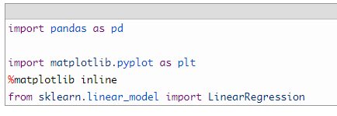
Import Data Science Libraries

